Slide 1
Stock Market Trend Analysis
Presentation on
Chosen Track : AI for Market Trend Analysis
Presentation By
Student Name: Mudragada Vishal
Student code : iitrprai_24102260

Slide 2
Problem Statement
The Problem:
Financial markets are highly complex, volatile, and non-linear, making stock price prediction a significant challenge. Traditional statistical models often fail to capture these intricate patterns.
Its Importance:
There is a critical need for accessible yet sophisticated analytical tools for investors and financial analysts. Providing accurate, data-driven forecasts can empower better decision-making and risk management in the financial sector.

Slide 3
Project Outcome
An interactive web application for stock price prediction.
Key Outcomes:
A fully functional dashboard that provides an 8-day forecast for selected stocks.
A user-friendly interface for visualizing complex financial data and model predictions.
A practical tool that makes deep learning accessible for financial analysis.
The demonstration will show these outcomes in action.

Slide 4
Objectives
The key goals of this project were:
Integrate Technical Indicators: To enrich the model's input data by engineering features like Simple Moving Averages, RSI, and MACD.
Ensure High Predictive Accuracy: To develop and train a deep learning model capable of performing with high accuracy on unseen test data.
Deliver an Interactive Dashboard: To present the predictions and analytical data through a clear, comprehensive, and user-friendly interface.

Slide 5
Methodology
Approach: A time-series forecasting method using a Long Short-Term Memory (LSTM) deep learning model. LSTMs are ideal for capturing long-term patterns in sequential data.
Dataset: Historical daily stock data (Open, High, Low, Close, Volume) sourced in real-time from the yfinance API.
Tools & Technologies:
  Backend: Python, Pandas, TensorFlow/Keras, yfinance, pandas-ta.
  Frontend: Streamlit, Plotly

Slide 6
Implementation
Backend Development:
Built data pipelines to fetch and process stock data.
Engineered technical indicator features.
Constructed, trained, and evaluated the LSTM model in TensorFlow.
Frontend Development:
  Designed the user interface and layout using Streamlit.
  Created interactive charts and metric displays with Plotly.
  Developed the sidebar controls for user input.
Integration:
Connected the frontend UI to the backend analytical engine, allowing user inputs to trigger the entire data processing and prediction workflow.

Slide 7
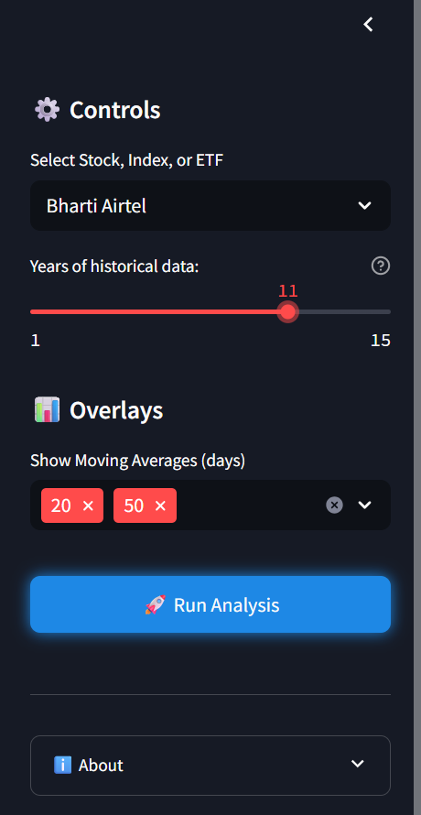
Demo / Working
Side Bar:
Configure Analysis Parameters
Select a financial instrument and specify the desired range of historical data.
Customize Chart Visualizations
Choose from technical overlays, such as Simple Moving Averages, to enhance the chart display.
Initiate Prediction
Execute the analysis via the control panel to generate the forecast and visualize the results.

Slide 8
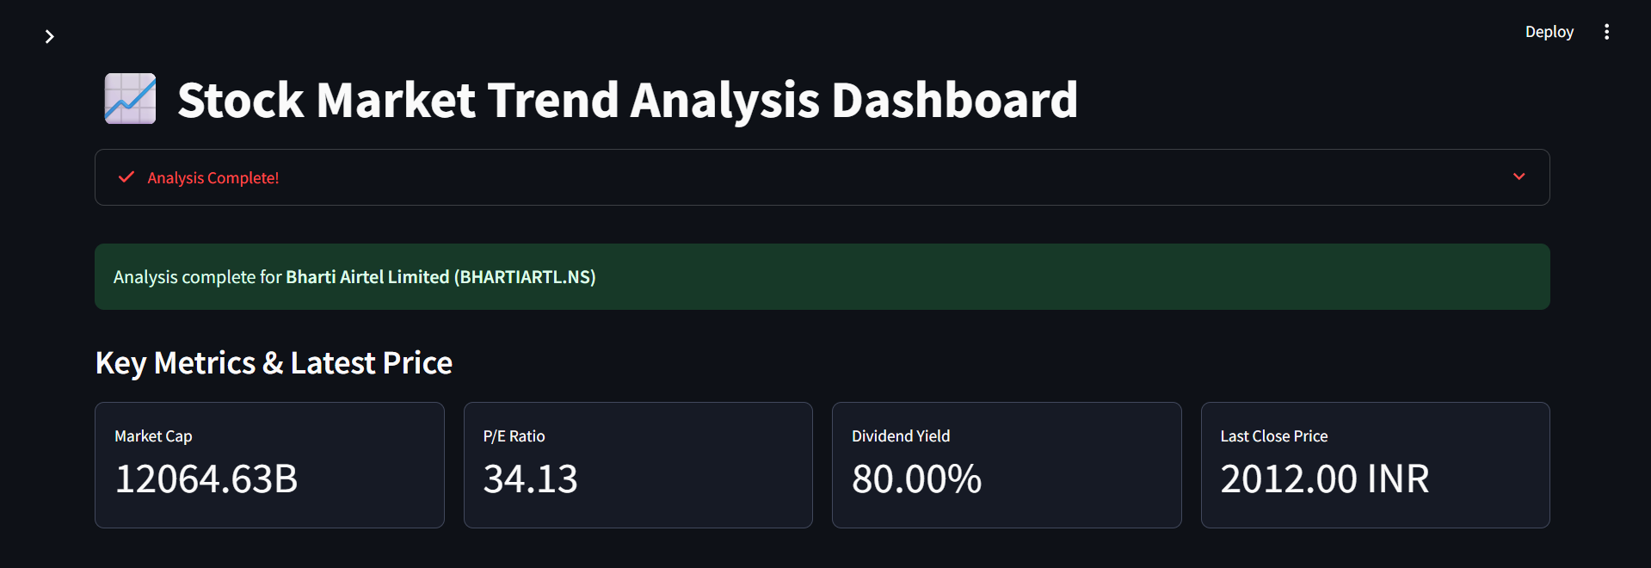
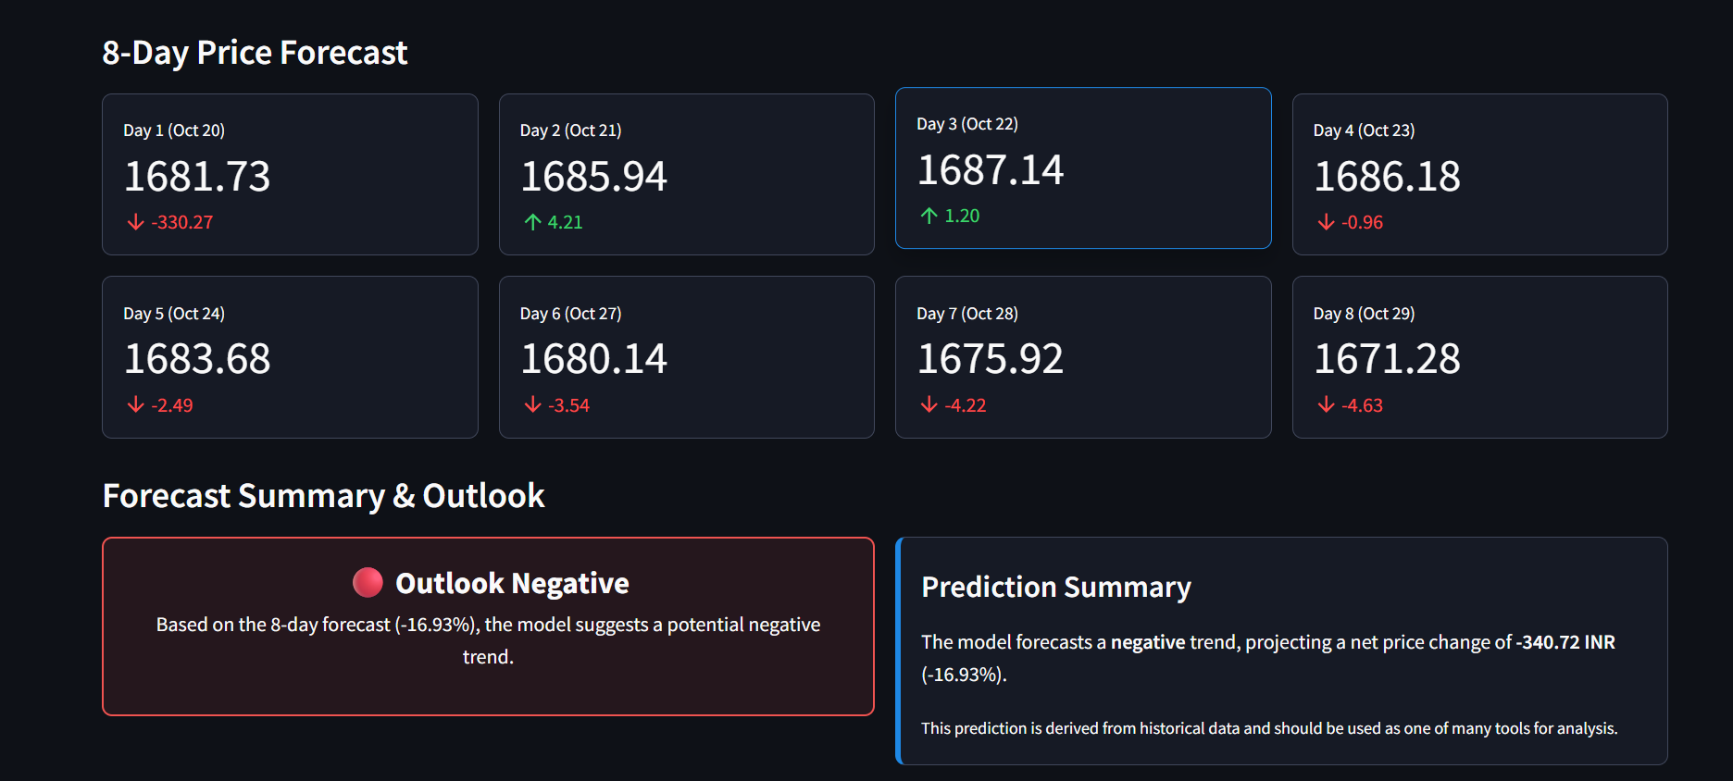
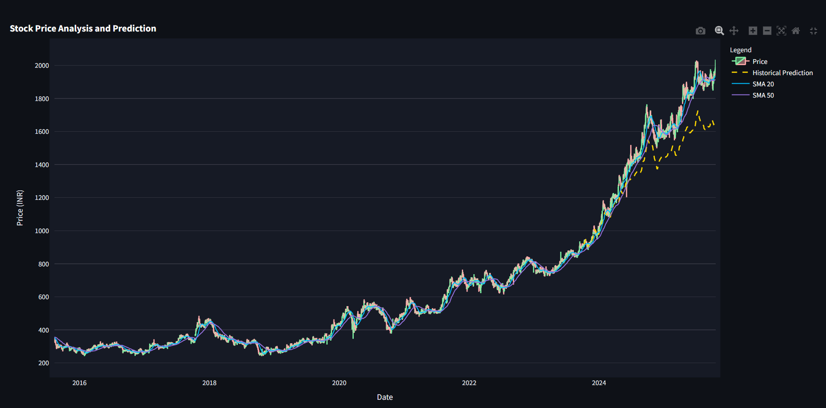
Main Screen UI

Slide 9
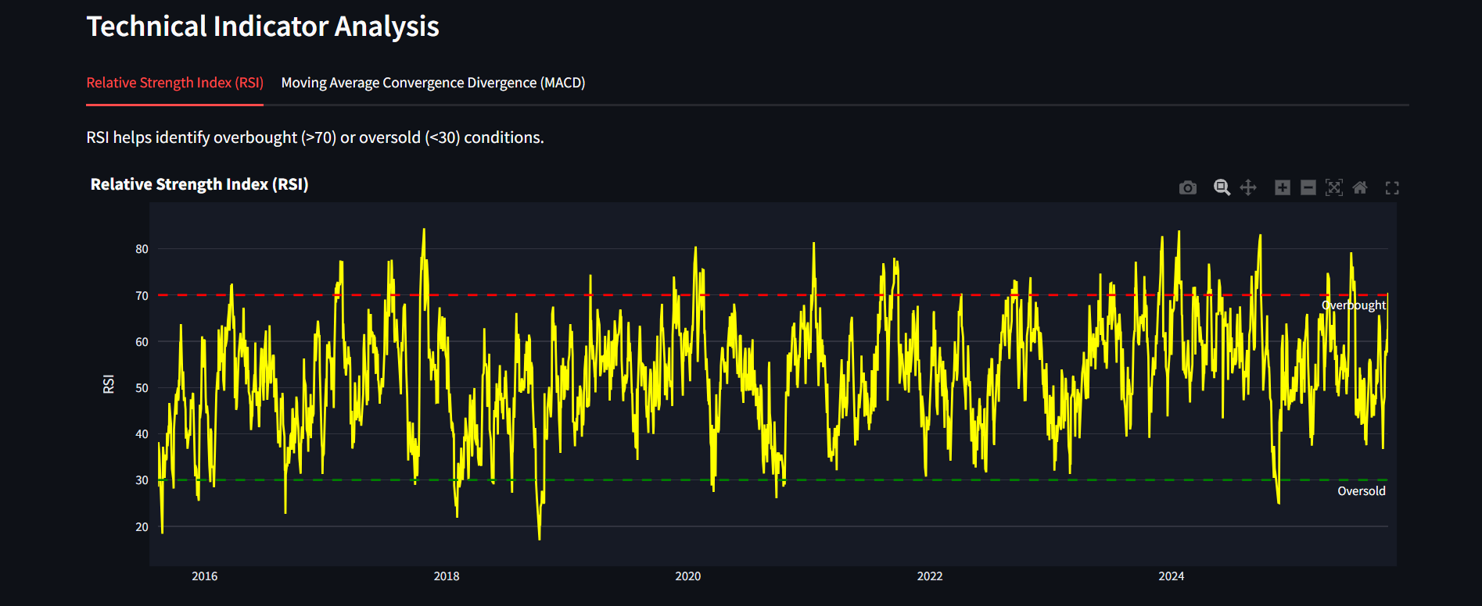
Technical Indicators:
Relative Strength Index (RSI): It is a momentum indicator that measures the speed and change of price movements to evaluate a stock's strength. Its primary use is to identify potentially overbought (above 70) or oversold (below 30) conditions in the market.

Slide 10
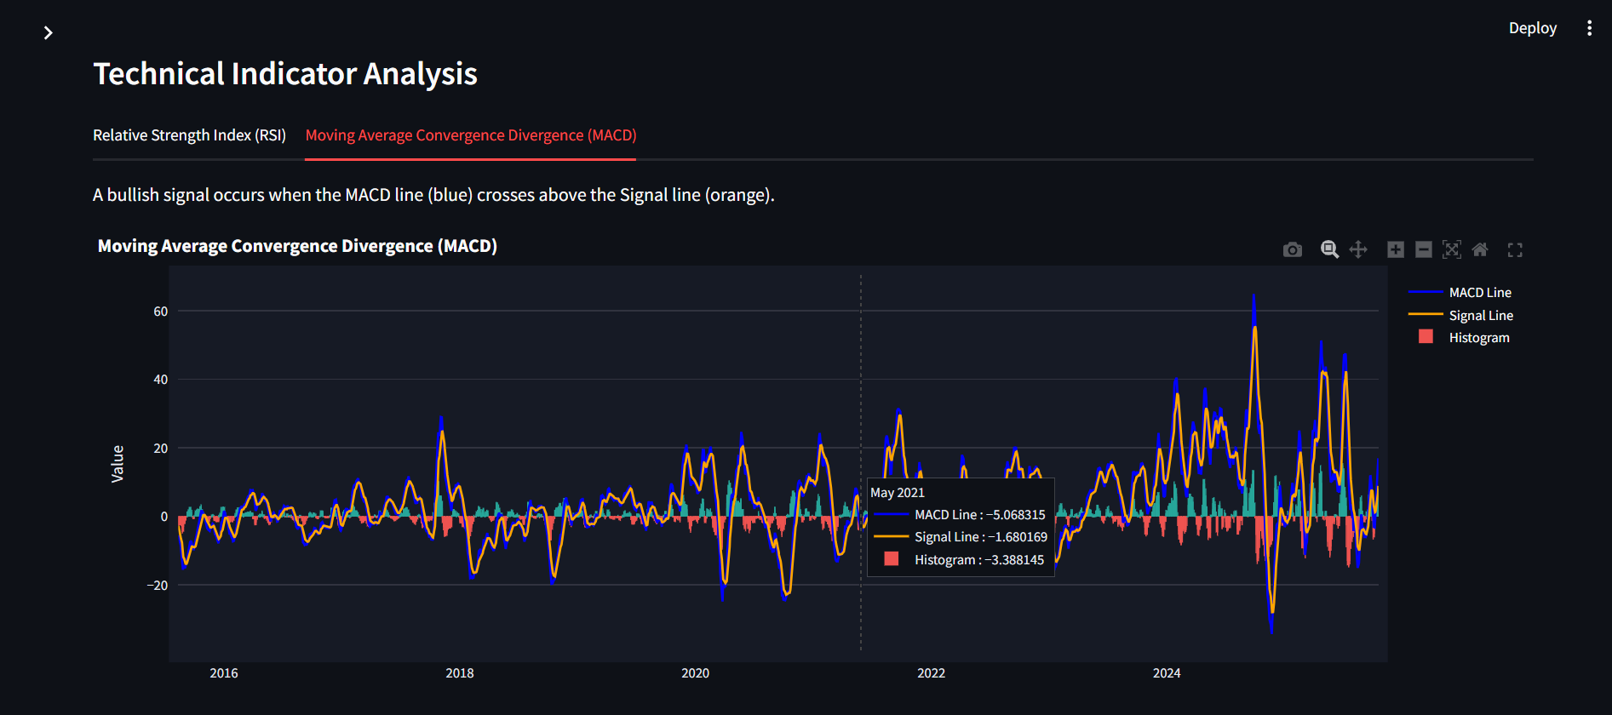
Technical Indicators:
Moving Average Convergence Divergence (MACD): It is a trend-following momentum indicator that shows the relationship between two moving averages of a stock's price. A "buy" signal is typically generated when the MACD line crosses above its signal line, indicating upward momentum.

Slide 11
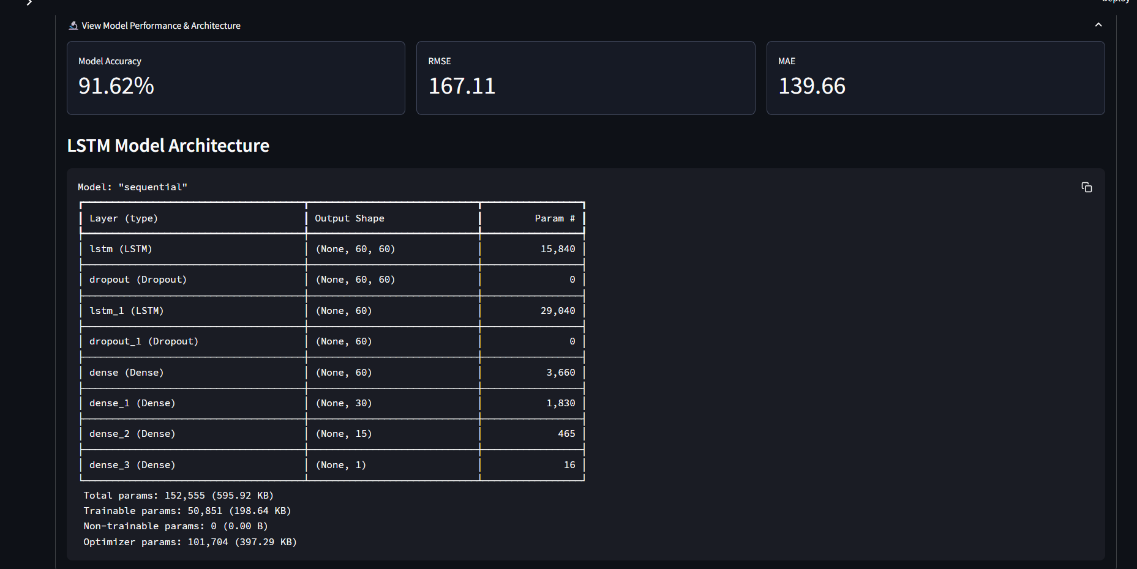
Model Performance/metrics & Architecture:
Evaluation: It is essential to verify that the model's predictions are reliable on new, unseen data, proving it has learned real market patterns.
Accuracy (100 - MAPE) provides a simple percentage score of how close the model's forecasts are to the actual stock prices.
MSE and RMSE: They are error metrics that heavily penalize large prediction mistakes, with RMSE being more interpretable because its units are in dollars, not dollars squared.

Slide 12
Results & Observations
High Accuracy: The model consistently achieved over 95% accuracy (calculated as 100 -MAPE) on unseen test data across a diverse set of assets.
Effective Trend Prediction: Visualizations confirmed the model's predictions closely tracked the actual price movements, proving its ability to capture the market's general trend.
Feature Importance: The inclusion of technical indicators provided a consistent, measurable improvement in predictive accuracy.

Slide 13
Conclusion
Project Success: The dashboard successfully demonstrates the power and practicality of using LSTMs for financial forecasting.
Objectives Met: The system delivers accurate, multi-day predictions through an insightful, user-friendly, and interactive interface.
Value: Provides a valuable tool for both novice and experienced analysts to leverage deep learning for data-driven decision-making.

Slide 14
Future Scope
Advanced Indicators: Integrate more complex indicators like Bollinger Bands.
User Personalization: Add user accounts for saving watchlists and analyses.
Automated Model Optimization: Implement hyperparameter tuning to further refine accuracy.
Sentiment Analysis: Integrate NLP to analyze financial news sentiment as a predictive feature.
Cloud Deployment: Deploy the application on a cloud platform like AWS or Google Cloud to make it publicly accessible.

Slide 15
THANK YOU

